Slide 1


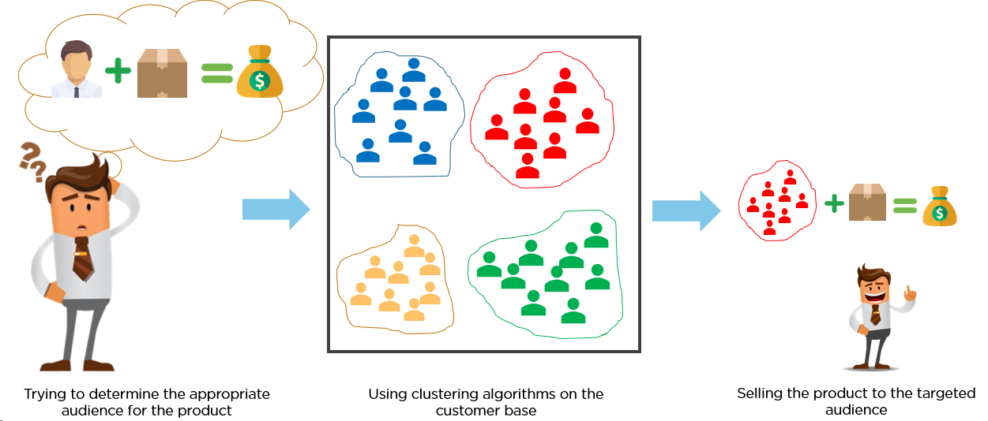
Clustering techniques in medical diagnosis
Asst. Prof. Dr. Watshara Shoombuatong
Center of Data Mining and Biomedical Informatics
watshara.sho@mahidol.ac.th

Slide 2
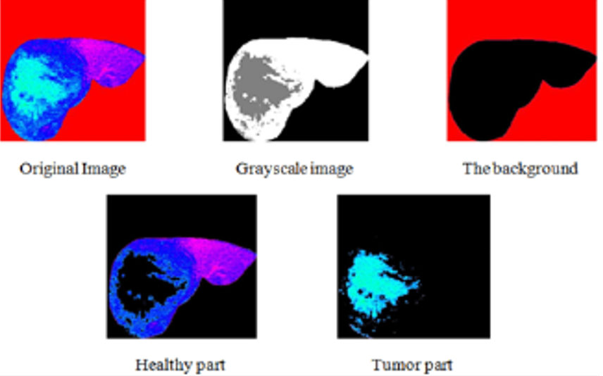

Slide 3
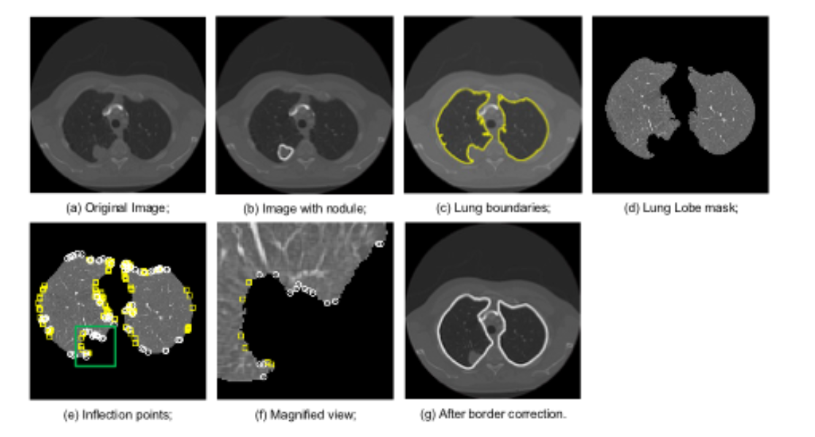

Slide 4
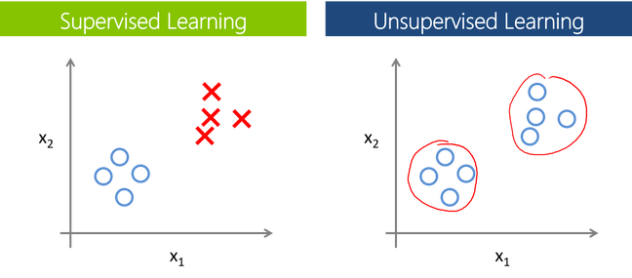
Overview of clustering

Slide 5
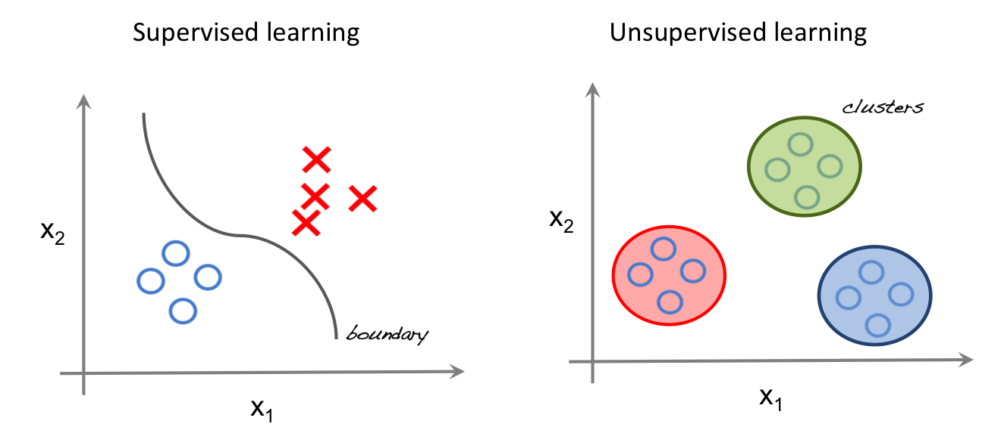
Overview of clustering

Slide 6

Overview of clustering

Slide 7
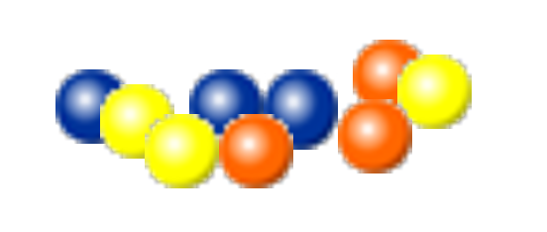
Overview of clustering
Clustering of data is a method by which large sets of data is grouped into clusters of smaller sets of similar data.
The example below demonstrates the clustering of balls of same colour. There are a total of 10 balls which are of three different colours.

Slide 8

Overview of clustering
The balls of same colour are clustered into a group as shown below :
Thus, we see clustering means grouping of data or dividing a large data set into smaller data sets of some similarity.

Slide 9
Overview of clustering
Clustering is an unsupervised data mining (machine learning) technique used for grouping the data elements without advance knowledge of the group definitions.
The objective of clustering is to find the intrinsic grouping in a set of unlabeled data.
Transform the set of features into subsets so that features in the same subset are similar in some sense

Slide 10
Overview of clustering
From the paper “Data clustering: review”
Feature Selection
identifying the most effective subset of the original features to use in clustering
Feature Extraction
transformations of the input features to produce new salient features.
Interpattern Similarity
measured by a distance function defined on pairs of patterns.
Grouping
methods to group similar patterns in the same cluster
Notes:
Features wrt microarray data can be genes
We will not talk about feature selection/extraction

Slide 11
Outline of discussion
Various clustering algorithms
Hierarchical
Heatmap
K-means
Principle component analysis (PCA)

Slide 12
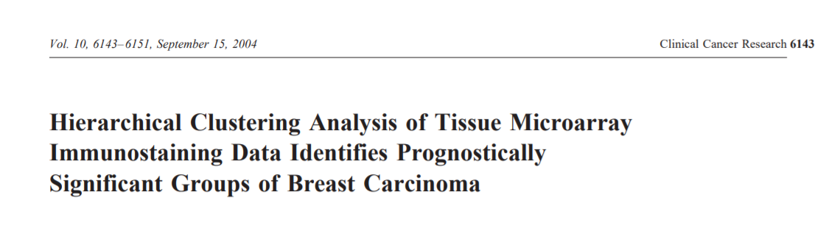

Slide 13
Hierarchical clustering
17 of 31 markers showed prognostic significance in univariate analysis (P < 0.05) and 4 markers showed a trend toward significance (P < 0.2).
Unsupervised hierarchical clustering analysis with the set of 11 markers reproduced the same three prognostically significant cluster groups (negative immunostaining; weak immunostaining; moderately intense immunostaining; strong immunoreactivity )identified by using the larger set of markers.

Slide 14
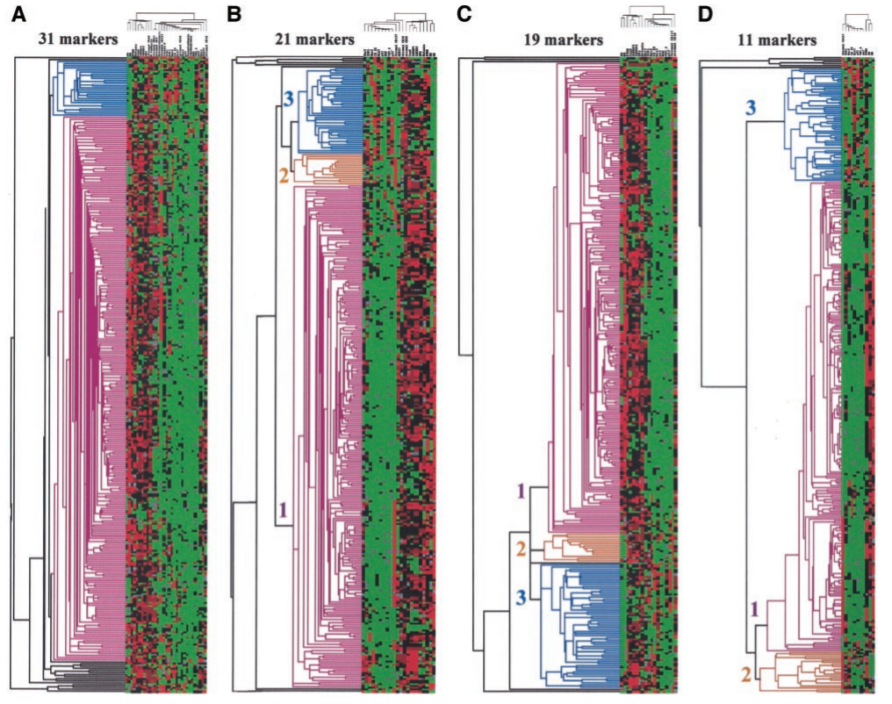
Clustergrams graphically depicting unsupervised hierarchical clustering analysis with 31(A), 21(B), 19(C), and 11(D) immunomarkers.
Each row, a single case; each column, a single immunomarker.
Green, negative immunostaining (score 0); black, weak immunostaining (score 1); brown, moderately intense immunostaining (score 2); red, strong immunoreactivity (score 3); gray, missing data.
They concluded that it is possible to identify prognostic cluster groups of invasive breast cancer patients with maximal differences in survival, by the clustering of immunostaining data, based on a panel of 11 prognostic markers.

